Slide 1


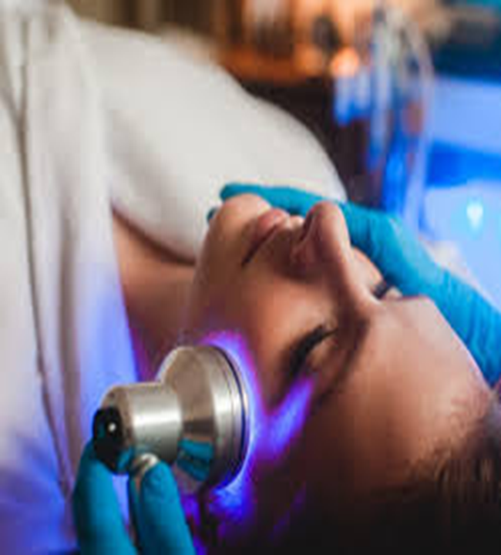
Medical physics first year
L13
Optical fiber
By Assistants professor
Dr.Mohammed Ali Jaber
Physiology Department
College of Medicine
University of Basrah

Slide 2
Optical fiber
Objectives
By the end of this section, the student learning about :
Reflection and Refraction
Total internal reflection
Optical fiber and its application in medicine
Endoscope
Fiber optic biomedical sensors
Optical coherence tomography (OCT),

Slide 3
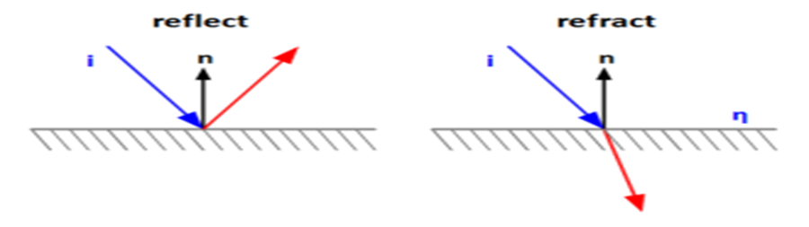
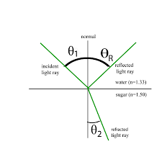
Reflection and Refraction
Reflection is the bouncing of light rays off a barrier or interface.
Refraction is the bending of light rays when passing through a surface between one transparent material and another.
The incident angle and the reflected angle are equal.
The refracted angle may be larger or smaller than the incident angle

Slide 4
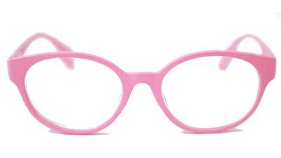
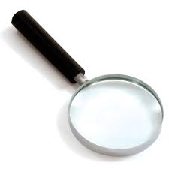
The refractive quality of lenses is frequently used to manipulate light in order to change the apparent size of images.

Slide 5
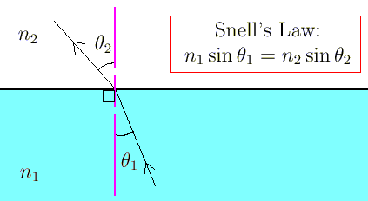
Snell's Law
Refraction is described by Snell's Law:
$n_{1 }\sin{θ_{1}}$= $n_{2}\sin{θ_{2}}$
n = 1 in a vacuum and
n > 1 in a transparent substance.

Slide 6
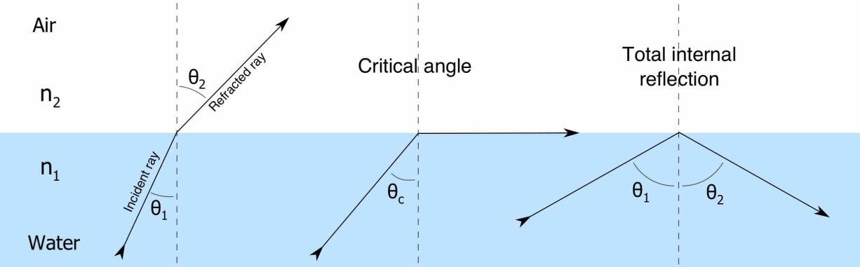
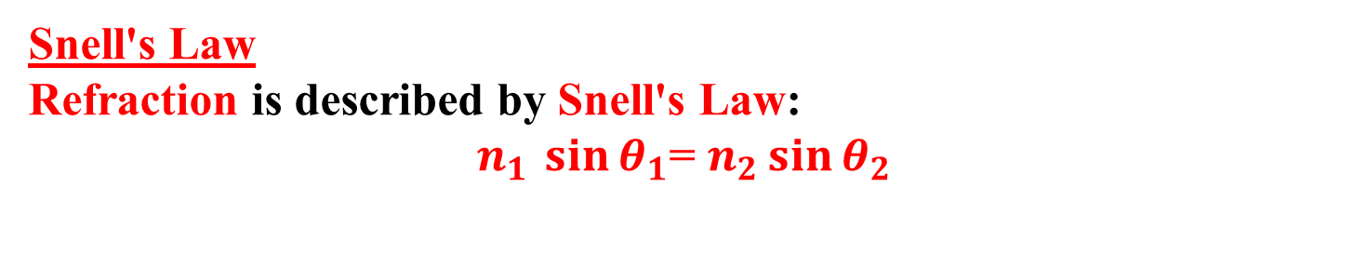
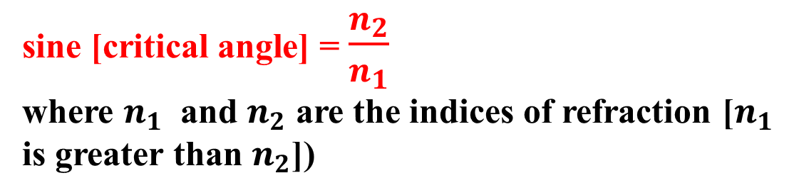
Total internal reflection
Snell's Law
Refraction is described by Snell's Law:
$n_{1 }\sin{θ_{1}}$= $n_{2}\sin{θ_{2}}$
sine [critical angle] = $\frac{n_{2}}{n_{1}}$
where $n_{1}$ and $n_{2}$ are the indices of refraction [$n_{1}$ is greater than $n_{2}$])

Slide 7
At a large enough incident angle ("critical angle"), the refracted angle is 90º and the refracted ray travels along the interface between the two media.
n₁sinø_{c} = n₂sin90º
sinø_{c} = n₂/n₁
At angles larger than ø_{c} no light travels out of the slower medium; it is all reflected internally.

Slide 8
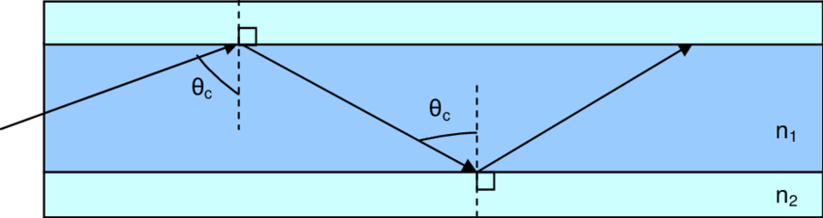
Total internal reflection: in physics, complete reflection of a ray of light within a medium such as water or glass from the surrounding surfaces back into the medium.
In general, total internal reflection takes place at the boundary between two transparent media when a ray of light in a medium of higher index of refraction approaches the other medium at an angle of incidence greater than the critical angle.
For a water-air surface the critical angle is 48.5°.

Slide 9
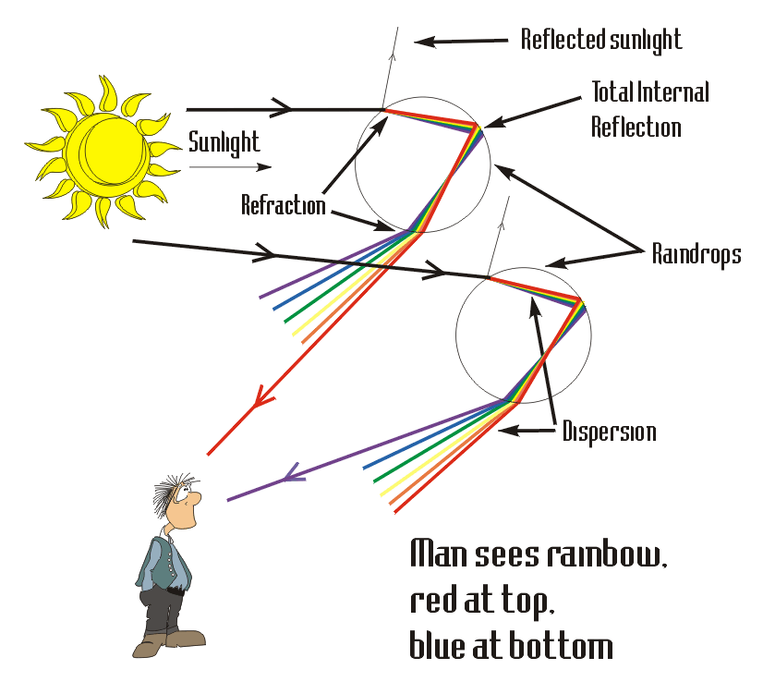
Because indices of refraction depend on wavelength, the critical angle (and hence the angle of total internal reflection) will vary slightly with wavelength and, therefore, with color.
At all angles less than the critical angle, both refraction and reflection occur in varying proportions.

Slide 10
Total internal reflection (TIR) is the phenomenon that involves the reflection of the entire incident light off the boundary.
TIR only takes place when both of the following two conditions are met:
The light is in the denser medium and approaching the less dense medium.
The angle of incidence is greater than the so-called critical angle.
Total internal reflection will not take place unless the incident light is traveling within the more optically dense medium towards the less optically dense medium.
TIR will happen for light traveling from water towards air, but it will not happen for light traveling from air towards water.

Slide 11
TIR would happen for light traveling from water towards air, but it will not happen for light traveling from water (n=1.333) towards crown glass (n=1.52).
TIR occurs because the angle of refraction reaches a 90-degree angle before the angle of incidence reaches a 90-degree angle.
The only way for the angle of refraction to be greater than the angle of incidence is for light to bend away from the normal.
Since light only bends away from the normal when passing from a denser medium into a less dense medium, then this would be a necessary condition for total internal reflection.

Slide 12
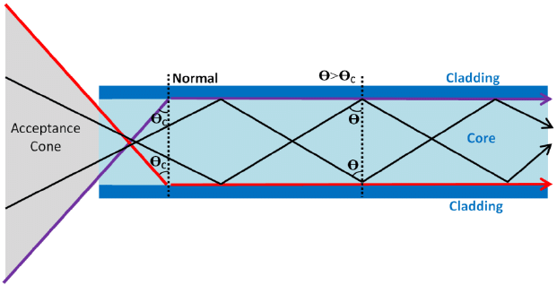
Optical fiber
The principle of fiber optic action is based through the process of Total Internal Reflection
Fiber optics, which is the science of light transmission through very fine glass or plastic fibers,

Slide 13
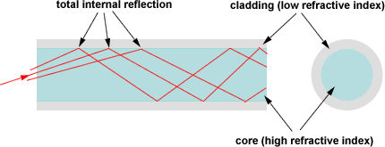
Optical fiber made of pure glass with a diameter of 125 microns equivalent to 0.125 mm consisting of the external reflective layer and internal transmission cylinder,
They have the capacity of carrying digital information in the form of optical signals over long distances

Slide 14
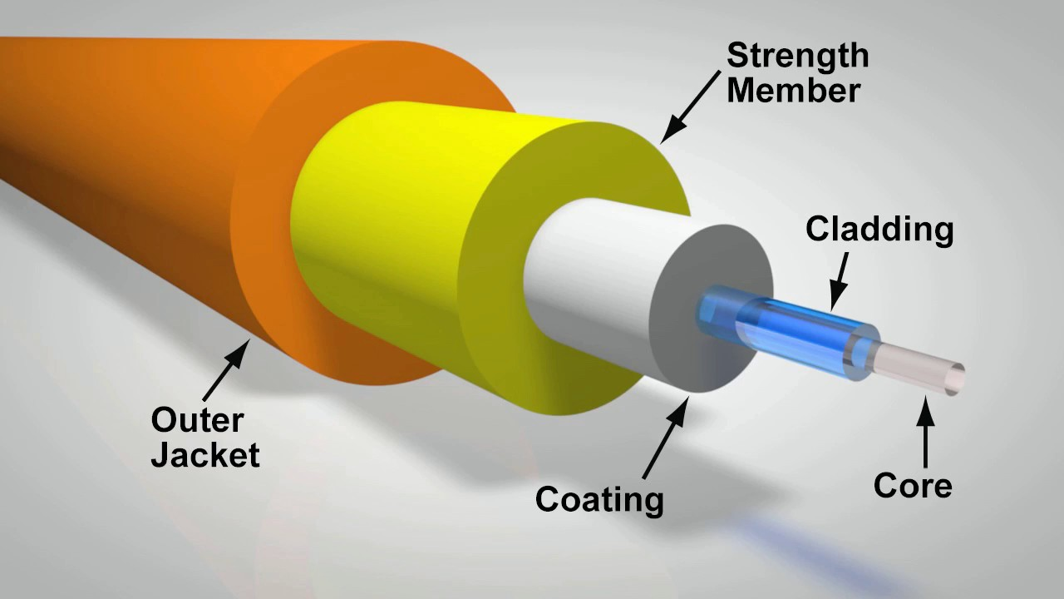
Optical fibers Generally they consist of three concentric layers:
Core (high reflective index) ,
Cladding(low reflective index )
Coating
Buffer
The light is "guided" down the core of the fiber by the optical "cladding" which has a lower refractive index that traps light in the core through "total internal reflection."

Slide 15
Fibre Optics Basics:
Light travelling in a medium of refractive index n₁ will experience total internal refraction at a boundary with a material of index n₂ if n₁ > n₂ and Ө>Ө_{c} where:
Sin Ө_{c} = n₂ / n₁
n₂
n₁
θ
θ

Slide 16
Total internal reflection keeps light rays bouncing down the inside of a fiber-optic cable.
n₂
θ
θ
n₁
θ
θ
α
• Acceptance Angle
In order to propagate down a fibre, a ray must be incident at the core-cladding interface at an angle > Өc
This places a limit on the range of angles which can enter the fibre: α < Өc

Slide 17
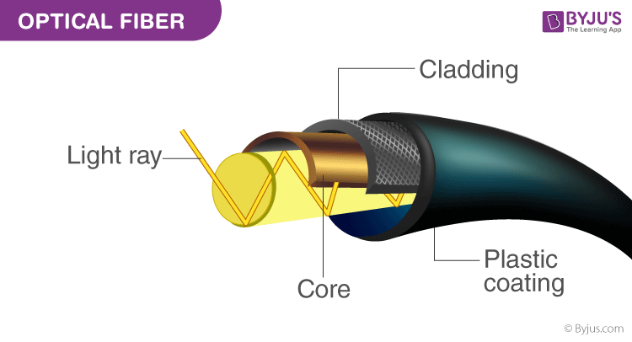
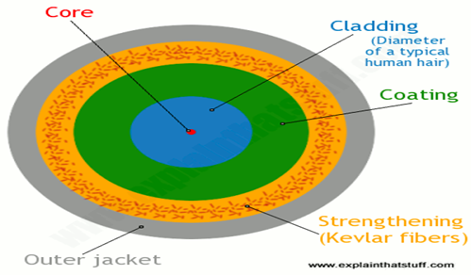
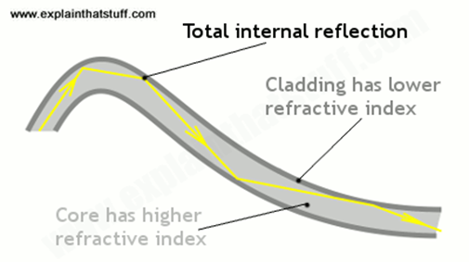
Type of optical fiber
Single-mode fiber is used for long-distance transmission,
Multimode fiber is used for shorter distances.

Slide 18
Fiber optics has several advantages over traditional metal communications lines:
Fiber optic cables have a much greater bandwidth than metal cables. This means that they can carry more data.
Fiber optic cables are less susceptible than metal cables to interference.
Fiber optic cables are much thinner and lighter than metal wires.
Data can be transmitted digitally (the natural form for computer data) rather than analogically
The main disadvantage of fiber optics is that the cables are expensive to install. In addition, they are more fragile than wire and are difficult to splice.

Slide 19
Applications of fiber optics in medicine
Fiber optics display a variety of characteristics that make them useful in the medical field.
They are insensitive to electromagnetic disturbances
Are commonly small in size.
Their ability to withstand high temperatures, strong electromagnetic fields like MRIs, and ionizing radiation make fiber optics the perfect medical tool.
Optical fibers are nontoxic, chemically inert, and intrinsically safe and thus, are an ideal material to use in and near the human body.

Slide 20
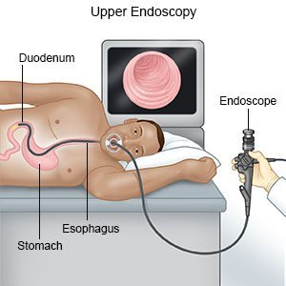
Endoscope
Endoscope: is a tube with built-in light sources, an instrument used to examine the interior of a hollow organ or cavity of the body.
Endoscopes use optical fibers to produce an image of inside the body.
An endoscope works by inserting a long, thin and bendable tube into the body . On one end is a light source and in most cases also a video camera.

Slide 21
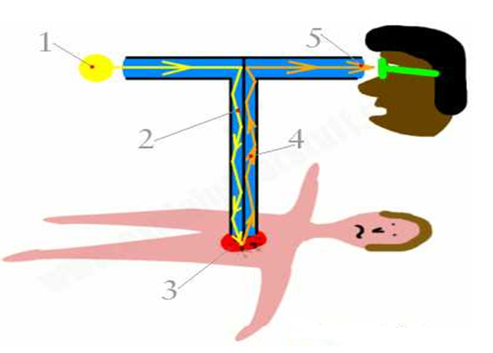
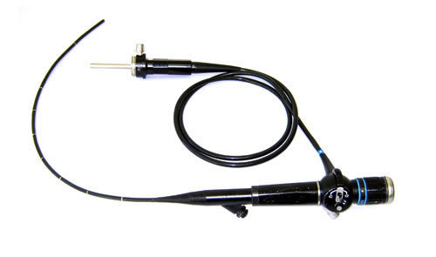
How do endoscopes work?

Slide 22
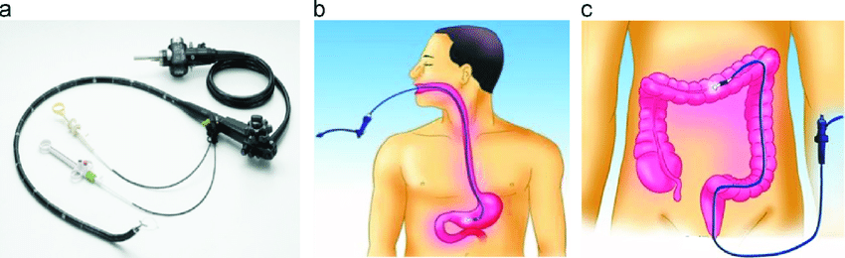
Doctors use endoscopes to investigate symptoms such as nausea and abdominal pain, confirm diagnoses by performing biopsies, or give medical treatment.
Endoscope
Throat

Slide 23
Type of endoscope
Specialized instruments are named after their target organ. Examples include
Endoscopes is used to examine the internal organs like the throat or esophagus.
The cystoscope (bladder),
Nephroscope (kidney),
Bronchoscope (bronchus),
Arthroscope (joints) and
Colonoscope (colon),
Proctoscopes (rectum)
Laparoscope (abdomen or pelvis).
They can be used to examine visually and diagnose, or assist in surgery such as an arthroscopy.

Slide 24
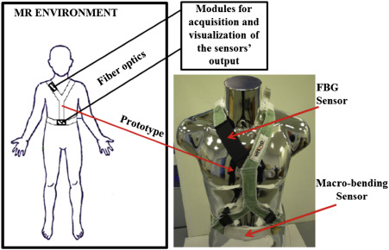
Fiber optic biomedical sensors
Fiber optic biomedical sensors are another huge application of fiber optic technology.
These sensors can be intrinsic or extrinsic and are able to measure a variety of physiological characteristics:
Body temperature,
Blood temperature,
Muscle displacement,
Heart rate

Slide 25
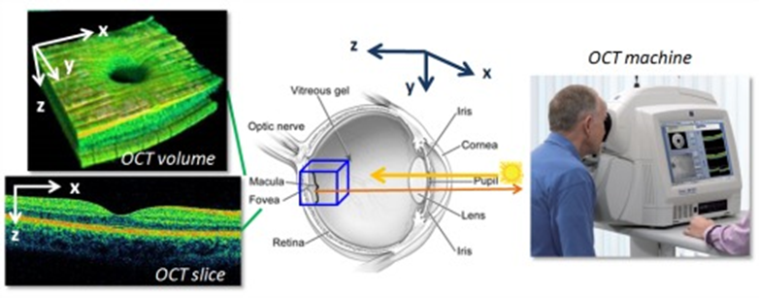
Optical coherence tomography (OCT),
Optical coherence tomography (OCT), a type of biomedical sensor, is a medical imaging technique that utilizes imaging sensors to capture micron-scale, two and 3-D images from within an optical scattering media, like biological tissue.

Slide 26


